Slide 1

ITIL® 4 Foundation Certification Course
Lesson 2: Key Concepts of Service Management
Based on AXELOS ITIL® material.
ITIL® is a [registered] trade mark of AXELOS Limited.

Slide 2


Learning Objectives
By the end of this lesson, you will be able to:
Interpret the meaning and nature of service management, value, and value co- creation
Categorize various stakeholders of ITSM such as organizations, service providers, service consumers, and other stakeholders
Identify the products, services, and service offerings of a service provider Describe the meaning and components of service relationship
Explain the service relationship model
Evaluate the relationships and value of outcomes, costs, risks, utility, and warranty

Slide 3



Introduction to Service Management and ITIL
Topic 1: Service Management, Value, and Value Co-creation

Slide 4


Definition of Service Management
Service management is a set of specialized organizational
capabilities for enabling value for customers in the form of services.

Slide 5
Definition of Service Management
Service management is a set of specialized organizational capabilities for enabling value for customers in the form of services.
To develop the specialized organizational capabilities, you must understand:
The nature of value
The nature and scope of
the stakeholders involved
Value creation through services

Slide 6
Key Concepts of Service Management
1
Nature of value and value co-creation
2
Organizations, service providers, service consumers, and other stakeholders
3
Products and services
4
Service relationships
5
Value of outcomes, costs, and risks

Slide 7
Key Concepts of Service Management
Understanding the key concepts and terminology of service management is critical to the effective use of ITIL guidance.

Slide 8

Understanding the Term Value
The purpose of an organization is to create value for stakeholders.
The term value is used regularly in service management.
It is a key focus area in ITIL 4 and must therefore be clearly defined.

Slide 9
Definition of Value
Value is defined as the perceived benefits, usefulness, and
importance of something.

Slide 10
Features of Value
Value is subject to the perception of stakeholders, whether they are the customers or consumers of a service or part of the service provider organization.
Hence, value is subjective.

Slide 11
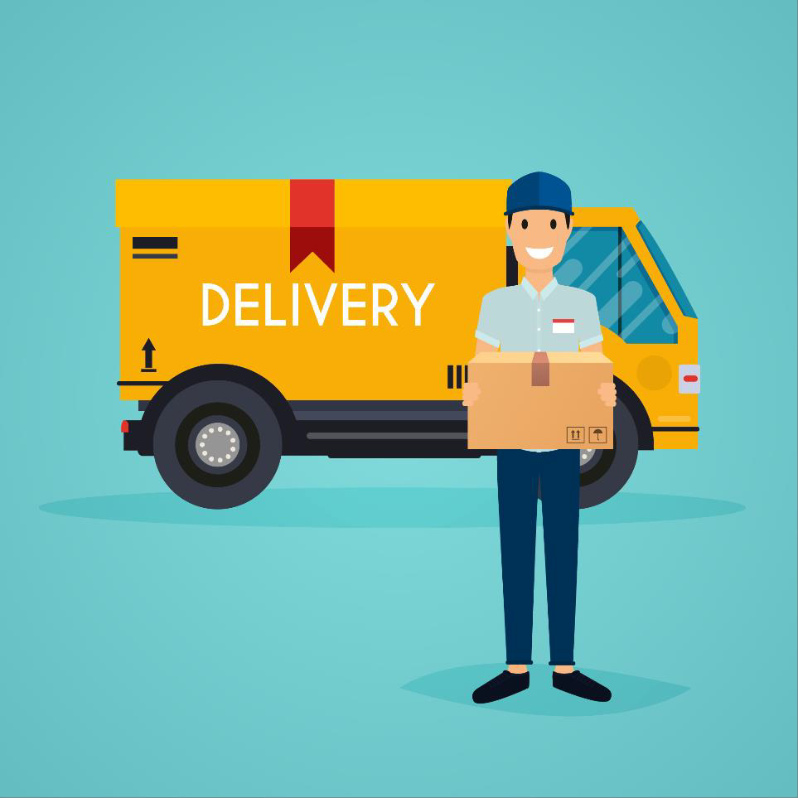
Traditional View of Value Co-creation
The traditional view of organizations delivering value to the customers is equivalent to that of a delivery company delivering a package to the customer.
The relationship between the service
provider and the service consumer is viewed as mono-directional and distant.

Slide 12

Traditional View of Value Co-creation
The service provider delivers the service and the consumer receives value. The consumer plays no role in the creation of value for themselves.
This view fails to consider the highly complex and interdependent service relationships that exist in reality.

Slide 13
Modern View of Value Co-creation
In the modern view, value is co-created through an active collaboration between providers and consumers, as well as other organizations that are part of the relevant service relationships.
Organizations who deliver services are referred to as service providers.
Those to whom services are delivered are referred to as service consumers.

Slide 14
Modern View of Value Co-creation
Service providers must avoid working in isolation while defining what their customers and users value.
They must actively seek to establish mutually beneficial and interactive relationships with their consumers, empowering them to be creative collaborators in the service value chain.

Slide 15
Introduction to Service Management and ITIL
Topic 2: Organizations, Service Providers, Service Consumers,
and Other Stakeholders

Slide 16






Stakeholders of ITSM
The most important stakeholders of ITSM include:
Organizations
Service providers
Service consumers
Other stakeholders

Slide 17
Stakeholders of ITSM
Let’s begin with the term organization.
Organizations
Service providers
Service consumers
Other stakeholders

Slide 18
Definition of Organization
An organization is defined as a person or a group of people that has it’s own functions with responsibilities, authorities, and relationships to achieve its objectives.

Slide 19
Features of Organization
Organizations vary in size, complexity, and their relation to legal entities.
The relationships within the organizations have become more complex.
Organizations
Each organization depends on others in its operation and development.
Organizations may hold different roles, depending on the perspective under discussion.

Slide 20
Stakeholders of ITSM
Organizations
Service providers
Service consumers
Other stakeholders

Slide 21
Service Providers
When provisioning services, an organization takes on the role of the service provider.
The provider can be external to the consumer’s organization, or they can
both be part of the same organization.

Slide 22
Service Providers
In the traditional view of ITSM, the provider organization is seen as the IT department of a company, and the other departments or units in the company are regarded as the consumers.
This is a simple provider-consumer model.

Slide 23
Service Providers
A provider could be selling services on the open market to other businesses, to individual consumers, or it could be part of a service alliance, collaborating to provide services to consumer organizations.
The organization in the provider role must have a clear understanding of who its consumers are in a given situation and who the other stakeholders are in the associated service relationships.

Slide 24
Stakeholders of ITSM
Organizations
Service providers
Service consumers
Other stakeholders

Slide 25
Service Consumers
When receiving services, an organization takes on
the role of the service consumer.

Slide 26
Roles of a Service Consumer
Service consumer is a generic role that is used to simplify the definition and description of the structure of service relationships.
In practice, there are more specific roles involved in service consumption, such as: o Customers
Users
Sponsors
These roles can be separate or combined.

Slide 27
Roles of a Service Consumer
Customer
A person who defines the requirements for a service and takes responsibility for the outcomes of service consumption.
User
A person who uses services.
Sponsor
A person who authorizes budget for service consumption.

Slide 28
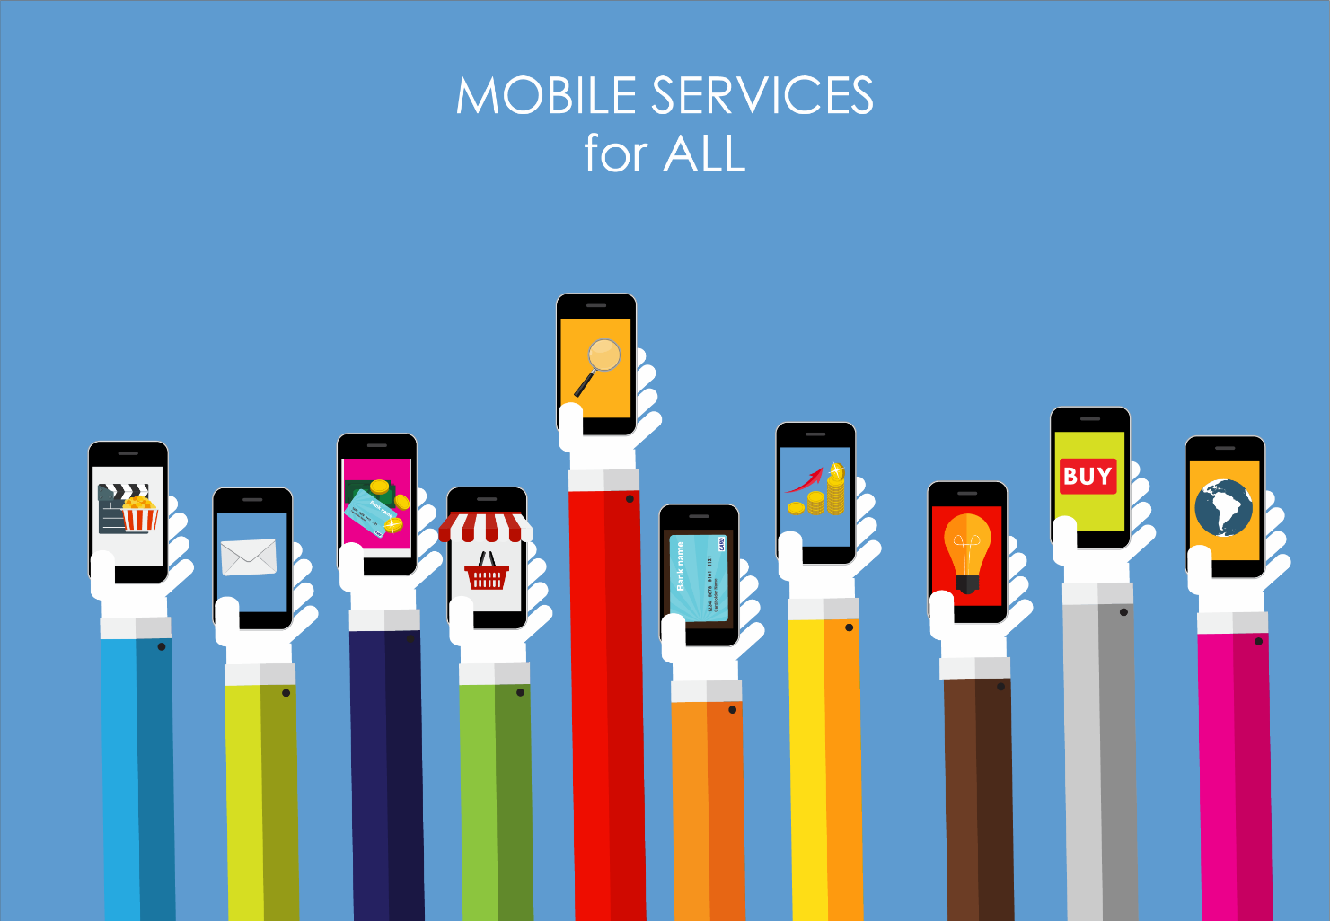
Example 1: Roles of Service Consumer
Let’s take an example of a company wishing to purchase mobile
phone services for its employees from a wireless carrier.

Slide 29
Example 1: Roles of Service Consumer
Customer
The Chief Information Officer (CIO) and key communication team members fill in the role of customer when they analyze the mobile communication requirements of the company’s employees, negotiate the contract with the wireless carrier, and monitor the carrier’s performance against the contracted requirements.
User
The Chief Financial Officer (CFO) fills the role of the sponsor when they review the proposed service
arrangement and approve the cost of the contract as negotiated.
Sponsor
The employees (including the CIO, CFO, and communications team members) fill the role of users when they
order, receive, and use the mobile phone services as per the agreed contract.

Slide 30

Example 2: Roles of Service Consumer
An individual private consumer of the same wireless carrier simultaneously acts as
a user, customer, and sponsor.
It is important to identify these roles in service relationships to ensure effective communication and stakeholder management.
Each of these roles may have different or even conflicting expectations
from services and different definitions of value.

Slide 31
Stakeholders of ITSM
Organizations
Service providers
Service consumers
Other stakeholders

Slide 32
Other Stakeholders
Organizations co-create value with their consumers through service relationships.
Beyond the consumer and provider roles, there are usually many other
stakeholders that are important to value creation.

Slide 33

Examples of Other Stakeholders
Individual employees of the provider organization
Partners and suppliers
Investors and shareholders
Government organizations and social groups

Slide 34
Significance of Other Stakeholders
It is important to understand and manage the relationships with all key stakeholder groups.
The provider’s relationships with its consumers can be in jeopardy if
stakeholders are unhappy.
Products and services create value for stakeholders. The value can be created through the generation of revenue or employee experience.

Slide 35
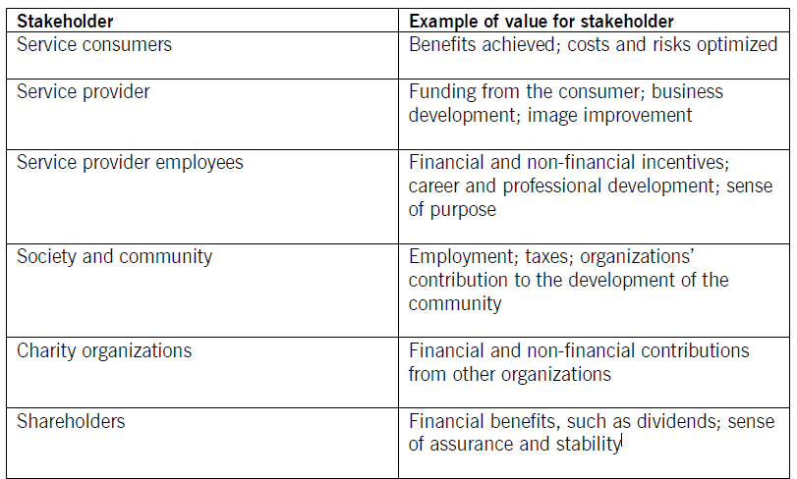
Examples of Value for Stakeholders
Table 2.1 Examples of value for different types of stakeholder

Slide 36
Introduction to Service Management and ITIL
Topic 3: Products, Services, and Service Offering

Slide 37
Products and Services in Service Management
Service is the central component of service management.
The services that an organization provides are based on one or more
of its products.
Organizations own or have access to a variety of resources including people, information and technology, value streams and processes, and suppliers and partners.
Products are configurations of these resources, created by the organization, that will potentially be valuable for its customers.

Slide 38
Definition of Service
Service is a means of enabling value co-creation by facilitating outcomes that customers want to achieve, without the customer having to manage specific costs and risks.

Slide 39
Definition of Product
Product is a configuration of organization’s resources designed to
offer value to a consumer.

Slide 40

Configuring Resources for Value Creation
Each product is created tailored to appeal to, and meet the needs of consumer groups.
A product can be used to address the needs of different consumer groups.
Products are typically complex and are not fully visible to the consumer.
The portion of a product that the consumer actually sees does not always represent all of the components that comprise the product and support its delivery.
Organizations define which product components their consumers see, and
tailor them to suit their target consumer groups.

Slide 41
Meaning of Service Offering
Service providers present their services to consumers in the form of service offerings, which describe one or more services based on one or more products.

Slide 42
Definition of Service Offering
Service offering is a description of one or more services, designed to address the needs of a target consumer group. It may include goods, access to resources, and service actions.

Slide 43
Components of Service Offering
Goods
Goods are supposed to be transferred from the provider to the consumer, with the consumer taking the responsibility for their future use.
Access to resources
The resources remain under the provider’s control and can be accessed by the consumer only during the
agreed service consumption period.
Service actions
The employees (including the CIO, CFO, and communications team members) fill the role of users when they
order, receive, and use the mobile phone services as per the agreed contract.

Slide 44
Components of Service Offering
Services are offered to target consumer groups, and those groups
may be either internal or external to the service provider organization.
Different offerings can be created based on the same product which allows it to be used in multiple ways to address the needs of different consumer groups.

Slide 45
Components of Service Offering
Component | Description | Examples
Goods | Supplied to the consumer Ownership is transferred to the consumer Consumer takes responsibility for future use | A mobile phone A physical server
Access to resources | Ownership is not transferred to the consumer Access is granted or licensed to the consumer under agreed terms and conditions The consumer can only access the resources during the agreed consumption period and according to other agreed service terms | Access to the mobile network or to network storage
Service actions | Performed by the service provider to address a consumer’s needs Performed according to an agreement with the consumer | User support Replacement of a piece of equipment
Table 2.2 Components of a service offering

Slide 46
Introduction to Service Management and ITIL
Topic 4: Service Relationships

Slide 47
Service Relationships
Service relationships are established between two or more
organizations to co-create value.
In a service relationship, organizations will take on the roles of service providers or service consumers.
The two roles are not mutually exclusive, and organizations typically
both provide and consume a number of services at any given time.

Slide 48
Definition of Service Relationship
Service relationship is defined as the cooperation between a
service provider and service consumer.

Slide 49
Components of Service Relationship
Service relationships include:
Service provision
Service consumption
Service relationship
management

Slide 50
Meaning of Service Provision
Service provision activities are the activities performed by an organization to provide services.
These include:
Management of the provider’s resources configured to deliver
the service
Access to these resources for users
Fulfilment of the agreed service actions
Service level management and continual improvement
Service provision may also include activities related to the supplying
of goods.

Slide 51
Meaning of Service Consumption
Service consumption is the activities performed by an organization to consume services.
Service consumption includes:
Management of the consumer’s resources needed to use the
service
Service actions performed by users, including utilizing the
provider’s resources and requesting service actions to be fulfilled
Service consumption may also include the receiving of goods.

Slide 52
Service Relationship Management
Service relationship management refers to the joint activities performed by a service provider and a service consumer to ensure continual value co- creation based on agreed and available service offerings.

Slide 53
Service Relationship Model
When services are delivered by the provider, they create new resources for service consumers, or modify their existing ones.
Examples:
A training service improves the skills of the consumer’s employees
A broadband service allows the consumer’s computers to communicate
A car-hire service enables the consumer’s staff to visit clients
A software development service creates a new application for the service
consumer

Slide 54
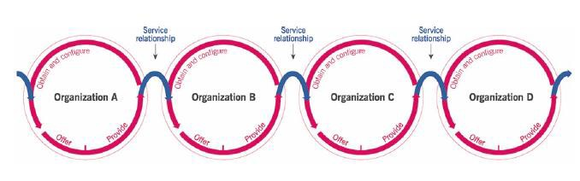
Service Relationship Model
The service consumer can use its new or modified resources to create its own products to address the needs of another target consumer group, thus becoming a service provider.
Figure 2.1 The service relationship model

Slide 55
Introduction to Service Management and ITIL
Topic 5: Outcomes, Costs, Risks, Utility, and Warranty

Slide 56
Value: Outcomes, Costs, and Risks
Associated
with
Require
Require
Outcomes
Resources
Costs
Risks
Service providers help their consumers to achieve outcomes, and in doing so, they take on some of the associated risks and costs.
On the other hand, service relationships can introduce new risks and costs, and in some cases, they can negatively affect some of the intended outcomes while supporting others.

Slide 57
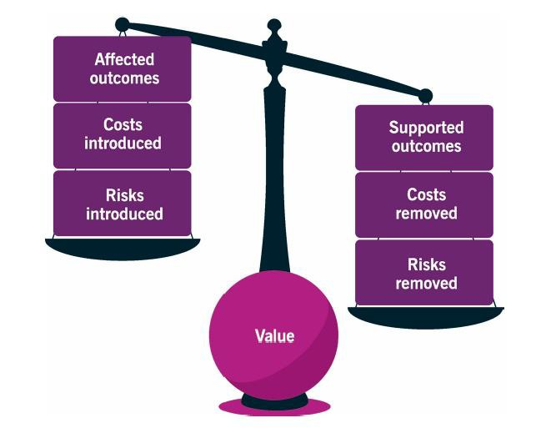
Value: Outcomes, Costs, and Risks
Service relationships are perceived as valuable only when they have more positive effects than negative.
Outcomes influence and are influenced by the other elements.
Figure 2.2 Achieving value: outcomes, costs, and risks

Slide 58



Output and Outcome
As a service provider, an organization produces outputs that help its consumers to achieve certain outcomes.
An outcome is a result for a stakeholder enabled by one or more outputs.
An output is a tangible or intangible deliverable of an activity.

Slide 59
Output and Outcome
It is important to understand the difference between outputs and outcomes.
The provider and consumer can work together to define the desired outcomes.
Another way to do this is that the consumers articulate their expectations and the
provider fulfills them.
Finally, some service providers predict or even create demand for certain outcomes, forming a target group for their services.

Slide 60
Definition of Cost
Cost is the amount of money spent on a specific activity or resource.

Slide 61
Types of Costs
Costs removed from the
consumer by the service
These may include costs of staff, technology, and other resources which the consumer does not need to pay for.
Costs imposed on the consumer by the service
The total cost of consuming a service includes the price charged by the service provider, plus other costs such as staff training, costs of network utilization, procurement, etc.
Some consumers describe this as what they have to invest to consume the service.

Slide 62
Types of Costs
Both the types of cost are considered when the consumer assesses the value which they expect the service to create.
To ensure that the correct decisions are made about the service relationship, it is important that both types of cost are fully understood.
From the provider’s perspective, a full and correct understanding of the cost of service
provision is essential.
Providers need to ensure that services are delivered within budget constraints and meet the financial expectations of the organization.

Slide 63
Definition of Risk
A risk is a possible event that could cause harm or loss or make it more difficult to achieve objectives. It can also be defined as an uncertainty of outcome and can be used in the context of measuring the probability of positive outcomes as well as negative outcomes.

Slide 64
Types of Risks
Risks removed from a consumer
by the service
These may include failure of the consumer’s server hardware or lack of staff availability.
In some cases, a service may only reduce a consumer’s risks, but the consumer may determine that this reduction is sufficient to support the value proposition
Risks imposed on a consumer by the service
An example of this would be a service provider ceasing to trade or experiencing a security breach.

Slide 65
Managing Risks
It is the duty of the provider to manage the detailed level of risk on behalf of the consumer.
This should be handled based on a balance of what matters most to the consumer and to the provider.
The consumer contributes to the reduction of risk through:
Actively participating in the definition of the requirements of the service and the clarification of its required outcomes
Clearly communicating the critical success factors (CSFs) and constraints that
apply to the service
Ensuring the provider has access to the necessary resources of the consumer throughout the service relationship

Slide 66
Utility and Warranty
To evaluate whether a service or service offering will facilitate the outcomes desired by the consumers and therefore create value for them, the overall utility and warranty of the service should be assessed.

Slide 67
Definition of Utility
Utility is the functionality offered by a product or service to meet a particular need.

Slide 68
Features of Utility
Utility can be summarized as what the service does and can be
used to determine whether a service is fit for purpose.
To have utility, a service must either support the performance of the consumer or remove constraints from the consumer.

Slide 69
Definition of Warranty
Warranty is defined as an assurance that a product or service will meet agreed requirements.

Slide 70
Features of Warranty
Warranty can be summarized as how the service performs and can
be used to determine whether a service is fit for use.
Warranty often relates to service levels aligned with the needs of service consumers.
This may be based on a formal agreement, or it may be a marketing message or brand image.
Warranty typically addresses such areas as the availability of the
service, its capacity, levels of security, and continuity.
A service can provide acceptable assurance, or warranty, if all defined and agreed conditions are met.

Slide 71
Utility and Warranty
The assessment of a service must take into consideration the impact of costs and risks on utility and warranty to generate a complete picture of the viability of a service.
Both utility and warranty are essential for a service to facilitate its desired outcomes and therefore help create value.

Slide 72

Example: Utility and Warranty
A recreational theme park may offer many exciting rides designed to deliver thrilling experiences for park visitors (utility), but if a significant number of the rides are frequently unavailable due to mechanical difficulties, the park is not fulfilling the warranty (it is not fit for use) and the consumers will not receive their expected value.
If the rides are always up and running during advertised hours, but they do not have features that provide the levels of excitement expected by visitors, the utility is not fulfilled, even though the warranty is sufficient. Again, consumers would not receive the expected value.

Slide 73
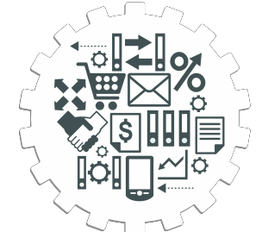
Key Takeaways
Service management is a set of specialized organizational capabilities for enabling value for customers in the form of services.
Value is co-created through an active collaboration between providers and consumers as well as other organizations that are part of the relevant service relationships.
The most important stakeholders of ITSM include organizations, service
providers, service consumers, and other stakeholders
When provisioning services, an organization takes on the role of the service provider. Whereas, when receiving services, an organization takes on the role of the service consumer.
Service is a means of enabling value co-creation by facilitating outcomes that customers want to achieve without the customer having to manage specific costs and risks.

Slide 74
Key Takeaways
Service offering is a description of one or more services designed to address the needs of a target consumer group. It may include goods, access to resources, and service actions.
Service relationship is defined as the cooperation between a service provider
and a service consumer.
Service providers help their consumers to achieve outcomes and in doing so,
take on some of the associated risks and costs.
A risk is a possible event that could cause harm or loss or make it more difficult to achieve objectives.
Utility is the functionality offered by a product or service to meet a particular need.
Warranty is defined as an assurance that a product or service will meet agreed requirements.

Slide 75
Thank You
ITIL® 4 Foundation Certification Course
Based on AXELOS ITIL® material.
ITIL® is a [registered] trade mark of AXELOS Limited.

